Slide 1
Enlisted Advancement
Notes:
Time Required: 70 min
FACILITATOR GUIDE:
As a CDT member, you may be asked to assist the ESO for advancement related questions within you dept/division. This lesson will help you in counseling Sailors regarding advancement opportunities.

Slide 2
Enabling Objectives
DISCUSS the enlisted advancement process and eligibility requirements
DISCUSS the Final Multiple Score (FMS) and contributing factors
IDENTIFY the process for calculating Performance Mark Average (PMA) and Reporting Senior’s Cumulative Average
DETERMINE Time-in-Rate/Time-in-Service advancement requirements
IDENTIFY the sources for Passed-Not-Advanced (PNA) points and how it is awarded
IDENTIFY advancement incentive programs
Notes:
FACILITATOR GUIDE:
Review objectives.

Slide 3
References
Advancement Manual for Enlisted Personnel of the U.S. Navy and U.S. Navy Reserve, BUPERSINST 1430.16G
Bibliography for Advancement Study, NAVEDTRA 10052
Catalog of Non-resident Navy Training Courses, NAVEDTRA 12061
Enlisted Navy Leadership Development, OPNAVINST 5351.2B
Manual of Navy Enlisted Manpower and Personnel Classification and Occupational Standards, NAVPERS 18068
Navy Military Personnel Manual, NAVPERS 15560
Navy Performance Evaluation System, BUPERSINST 1610.10G
Applicable NAVADMINs
Notes:
FACILITATOR GUIDE:
Review references.

Slide 4
Enlisted Advancement Computing Eligibility Requirements Terms
Service in Paygrade (SIPG)
The amount of time a candidate has served in a paygrade
Time-In-Rate (TIR) Date
Date from which an advancement candidate's total service in paygrade is considered to have commenced
Time-In-Service (TIS)
Total time in the Navy and is calculated based off the Sailor’s Pay Entry Base Date (PEBD)
Terminal Eligibility Date (TED)
Date to which an advancement candidate’s SIPG is computed for advancement purposes
Limiting Date
Date that advancement authorizations expires for respective advancement cycles
Notes:
FACILITATOR GUIDE:
To understand the different components to determine advancement eligibility; counselors must understand the terms.

Slide 5
Enlisted Advancement Advancement Eligibility
Be recommended by CO/OIC
Have minimum Time-In-Rate (TIR)
Time-In-Service (TIS from E1-E4)
Be in the proper path of advancement
Meet special requirements (citizenship, security, medical, ASVAB) for certain ratings
If required, complete service schools
Evaluation completed within computation period for advancement cycle
Computation dates received from applicable NAVADMIN
Maintain physical readiness per OPNAVINST 6110.1K
Must not have Fleet Reserve Request Pending/Approved if before HYT date
Notes:
FACILITATOR GUIDE:
These are the requirements a Sailors must meet to be eligible for advancement. Some of the requirements can be waived. This can be found in chapter 2 of BUPERSINST 1430.16.

Slide 6
Enlisted Advancement Terminal Eligibility Date (TED)
The advancement exam NAVADMIN will provide the TED based on the chart below.
If member advanced from a NWAE cycle, new Time-In-Rate (TIR) will be adjusted to the applicable TED.
Example: PO3 advanced to PO2 from the March 2027 cycle, members new TIR date will be 1 July 2027.
EXAMINATION MONTH | ADVANCEMENT TO | TED
February/March | E4 through E6 | 1 July of the same year
August/September |  | 1 January of the next year
November | E8 and E9 | 1 October of the next year
January/February | E7 | 1 January of the next year
Notes:
FACILITATOR GUIDE:
None

Slide 7
Enlisted Advancement Time Requirements
Paygrade | Time
E1 to E2 | 9 months (Time in Service)
E2 to E3 | 18 months (Time in Service)
E3 to E4 | 30 months (Time in Service)
E4 to E5 | 12 months (Time in Rate)
E5 to E6 | 36 months (Time in Rate)
E6 to E7
E7 to E8
E8 to E9
Time in Service is based on Pay Entry Base Date
Notes:
FACILITATOR GUIDE:
Note that Time in Service is different than Time in Rate.
Time in rate is the minimum amount of time a Sailor must spend in their current paygrade to be eligible for advancement to the next rank. Page 27 of BUPERSINST 1430.16(s) has the TIR chart seen above.
For advancement to E4-E9, TIR is calculated to the TED of the advancement cycle.
E-6 candidates TIR requirements for early promote (EP) Sailors can be waived by one year with commanding officer (CO)/officer in charge (OIC) approval, IAW paragraph 214.e of BUPERSINST 1430.16F
EAW must be manually created for all E-6 EP TIR waiver authorized candidates.

Slide 8
Enlisted Advancement Billet Based Advancement (BBA)
Beginning with the March 2025 exam, the Navy-wide Advancement Exam (NWAE) for advancement to E-5 and E-6 transitioned to a Rating Knowledge Exam (RKE) for the following rates: ABE, ABF, ABH, AME, AO, CS, DC, EM, GM, GSM, IC, MM, QM, and RS.
Sailors are only required to pass the RKE once every 2 years per paygrade and all Time-in-Rate (TIR) requirements to take the exam are removed at the E-4 and E-5 paygrades
Although not required to do so, Sailors who pass the RKE may voluntarily take future RKEs to improve their marketplace score as measured by the SSC to become more competitive in the marketplace through a higher exam score
Sample SSC. Always verify on MyNavy HR
Scoring Element | Weight Multiplier
Rating | 10
Pay Grade | 25
NEC | 15
Sailor App Ranking | 20
Command Ranking | 5
FMS | 15
Sea Credit | 10
Tie Breaker Time in Grade and then Time in Service
Sailors Scoring Criteria (SSC)
Notes:
FACILITATOR GUIDE:
Always make sure you are using the most recent advancement NAVADMIN when counseling Sailors on SSC and DMAP.

Slide 9
Enlisted Advancement Final Multiple Score (FMS)
The FMS method looks at the whole person and contributing factors vary by paygrade
E-5/6
Performance Evaluations
Experience (service in paygrade, awards, PNA points)
Exam score (standard score)
Education points
E-7
Performance Evaluations
Exam score
Notes:
FACILITATOR GUIDE:
The FMS determines whether a Sailor advances or not. Always make sure you are using the most recent advancement NAVADMIN when counseling Sailors.

Slide 10
Enlisted Advancement FMS E4 to E5
Exam Standard Score (SS) – 80 points / 47%
Performance Mark Average (PMA) – 64 points / 38%
Service In Paygrade (SIPG) – 2 points / 1%
Award points – 10 points / 6 %
Education points – (2 AA or 4 BA/BS) – 4 points / 2%
PNA Points – 9 points / 6 %
Total Possible Points – 169 / 100%
Notes:
FACILITATOR GUIDE:
This slide shows the max possible points E5 candidates receive for each category.

Slide 11
Enlisted Advancement FMS E5 to E6
Exam Standard Score (SS) – 80 points / 36%
Performance Mark Average / Reporting Senior Cumulative Average (RSCA) (PMA) – 114 points / 51%
Service In Pay Grade (SIPG) – 3 points / 1%
Award points – 12 points / 6 %
Education points – (2 AA or 4 BA/BS) – 4 points / 2%
PNA Points – 9 points / 4 %
Total Possible Points – 222 / 100%
Notes:
FACILITATOR GUIDE:
This slide shows the max possible points E6 candidates receive for each category.

Slide 12
Enlisted Advancement FMS E6 to E7
Determining Board Eligibility:
Exam Standard Score (SS) – 80 points / 40%
Performance Mark Average / Reporting Senior Cumulative Average (RSCA) (PMA) – 120 points / 60%
Total Possible Points – 200 / 100%
Notes:
FACILITATOR GUIDE:
Max possible points E7 candidates can receive for each category.

Slide 13
Enlisted Advancement Calculating PMA/RSCA PMA
Compute Performance Mark Average (PMA) (E5 Exam) and Reporting Senior Communitive Average (RSCA) PMA (E6/E7 Exam) using only the evaluations that fall within the prescribed dates outlined in the applicable advancement exam cycle NAVADMIN.
For example: NAVADMIN 032/25 and NAVADMIN 183/24:
E7 - 1 January 2022 to 31 December 2024
E6 - 1 March 2022 to 28 February 2025
E5 - 1 December 2023 to 28 February 2025
Notes:
FACILITATOR GUIDE:
PMA is calculated using your evaluations. Ensure to review the current NAVADMIN to obtain which evaluations are to be used to compute PMA by paygrade.
RSCA PMA will be explained in future slides.

Slide 14
Enlisted Advancement Promotion Recommendation
FMS Points
Block 45 | PMA | E-5 | E-6
EP | 4.0 | 64 | 114
MP | 3.8 | 48 | 98
P | 3.6 | 32 | 82
PROG | 3.4 | 16 | 66
Notes:
FACILITATOR GUIDE:
FMS chart can be found in BUPERSINST 1430.16 page 18.
Take note the differences in points that a Sailor can get between the performance blocks.

Slide 15
Enlisted Advancement RSCA PMA
Rewards additional PMA points towards their FMS
Members Individual Trait Average (ITA) is compared to the RSCA and extra points are provided for how far above RSCA a member's ITA is.
Each Advancement cycle NAVADMIN will provide guidelines on each evaluation used to provide RSCA PMA values
The RSCA PMA calculation is included in the automated Enlisted Advancement Worksheet (EAW)
Manual input can be done by ESO
Notes:
FACILITATOR GUIDE:
Show NAVADMIN 312/18 or additional recent updates as applicable.

Slide 16
Enlisted Advancement RSCA PMA
Example to calculate provided in Facilitator Guide
ITA Points Above RSCA | Additional RSCA Points
0.05 to 0.19 | 0.20
0.20 to 0.34 | 0.40
0.35 to 0.49 | 0.60
0.50 to 0.64 | 0.8
0.65 to 0.79 | 1.00
0.80 to 0.94 | 1.20
0.95 to 1.09 | 1.40
1.10 to 1.24 | 1.60
1.25 or greater | 1.80
Notes:
FACILITATOR GUIDE:
Show counselors how to calculate RSCA. Example problems are in NAVADMIN 312/18.
Example from NAVADMIN:
Each of the RSCA evaluation values will be added together and divided by the number of evaluations to get the RSCA PMA (rounded to two decimal places).
EXAMPLE: EVAL 1: EP; ITA = 4.71; RSCA = 3.77; POINTS ABOVE RSCA = 0.94
EVAL 2: MP; ITA = 4.29; RSCA = 3.86; POINTS ABOVE RSCA = 0.43
EVAL 3: P; ITA = 3.14; RSCA = 3.58; POINTS ABOVE RSCA = 0.00
RSCA EVAL1 = 4.00 + 1.20 = 5.20
RSCA EVAL2 = 3.80 + 0.60 = 4.40
RSCA EVAL3 = 3.60 + 0.00 = 3.60
RSCA PMA = (5.20 + 4.40 + 3.60)/3 = 4.40
Note: The RSCA value for each evaluation will be a requirement for computing RSCA PMA. If the RSCA value is missing for any of the evaluations in the PMA of the advancement cycle computation period, then RSCA PMA will be equal to 0.00 and will be considered a discrepancy until resolved by the command.

Slide 17
Enlisted Advancement Pass but Not Advanced (PNA) Points
PNA points come from two sources
PMA
Exam Standard Score (SS)
Awarded to those who pass the exam, but are not advanced due to quota limitations
Points awarded each exam cycle based on relative ranking to peers
Top 25% PMA =1.5 points
Top 25% SS = 1.5 points
Up to 3.0 total PNA points earned per exam cycle, for up to 3 cycles
Notes:
FACILITATOR GUIDE:
PNA points are only creditable for E5 through E6 candidates who achieve high NWAE standard scores or have high PMAs during the advancement cycle in which the candidate competed for advancement but were not advanced due to quota limitations.
Note that for those who have been in the Navy for some time were used to PNA points going back to the last 5 exams and that has since been updated.

Slide 18
Enlisted Advancement Exam Schedule
Jan​ | 3rd ​ | Thursday​ | E-7​
Mar​ | 1st ​ | Thursday​ | E-6​
 | 2nd ​ | Thursday​ | E-5​
Sep​ | 1st ​ | Thursday​ | E-6​
 | 2nd ​ | Thursday​ | E-5​
SELRES​ | 1st -28th (29th)​ | February​ | E5-E7 Exam​
SELRES​ | 1st -31st ​ | August​ | E-5/E-6​
Notes:
FACILITATOR GUIDE:
Eligible Sailors are still required to complete PMK-EE and be promotion recommended. Examinations for E-5, E-6, and E-7 candidates will always be on Thursdays (unless changed by published NAVADMINs).
SELRES E-3 to E-4 fall under the PRISE-R advancement process. Advancement exams are not required.
The Enlisted Advancement Worksheet (EAW) is the authoritative source of all data used to determine advancements.
Professional Military Knowledge - Eligibility Exam (PMK-EE) completion deadline normally is 31 December prior to taking advancement exams. For more details please see most recent NAVADMIN.

Slide 19
Enlisted Advancement Exam Participation Requirements
Enlisted Leadership Development Courses are required prior to taking the exam for E6 and E7 candidates
Professional Military Knowledge Eligibility Exam (PMK-EE) is mandatory for participation in advancement cycle
Complete once per paygrade (Except E4)
E-5 through E-7 candidates
Sailors must review the following
Evals, Awards, Degree level, PMK-EE completion, ELD and PMA or RSCA PMA computation on Enlisted Advancement Worksheet (EAW)
EAW located in NSIPS
Sailors must sign verifying it is accurate and then route to Educational Services Officer (ESO)
Education points will not be on the EAW but if Sailor has a degree, ensure it is in the service record
Notes:
FACILITATOR GUIDE:
Slides 20-21 provides the steps to completing the EAW worksheet.

Slide 20
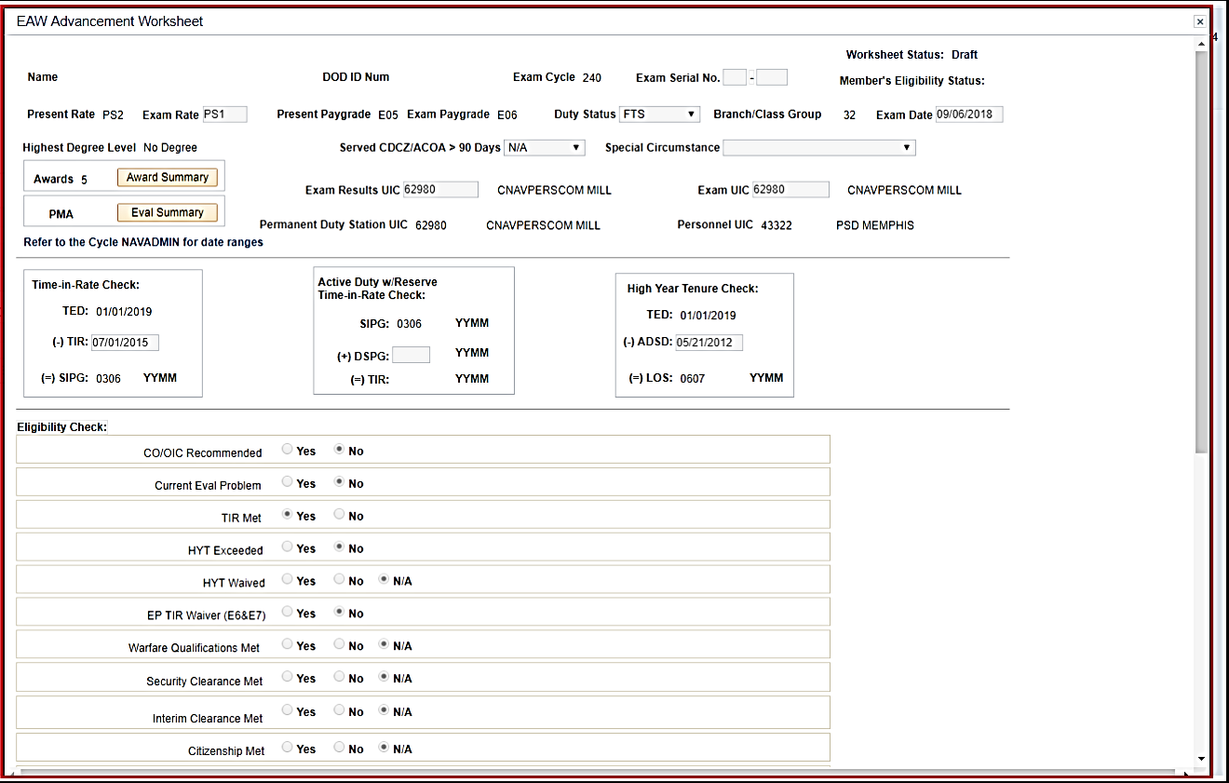
Enlisted Advancement Enlisted Advancement Worksheet (EAW)
EAW Example via NSIPS:
Notes:
FACILITATOR GUIDE:
Once the Sailor has clicked “View Worksheet” – a pop up window will appear (they may need to enable their pop-ups!)
This is their actual worksheet.
Sailors should verify ALL of the data/information to ensure everything is accurate.
Why is it important to verify Time in Rate?
1. To verify the Sailor is actually eligible for the exam and
2. because it involves points on the overall score. If TIR is only showing 0300 vice 0500 – this is a big difference.

Slide 21
Enlisted Advancement Enlisted Advancement Worksheet (EAW)
Verify your information:
DOD ID Number
Exam Cycle
Present Rate/Exam Rate
Present Paygrade/Exam Paygrade
Highest Degree Level
Duty Status
Are you taking the exam for a special circumstance (i.e. EP Waiver or LDO purposes)
Exam Results
Exam UIC
Time in Rate
Security Clearance Met (If applicable)
ELD Course completion (if applicable)
PMK-EE Completion
Notes:
FACILITATOR GUIDE:
Once the Sailor has clicked “View Worksheet” – a pop up window will appear (they may need to enable their pop-ups!)
This is their actual worksheet.
Sailors should verify ALL of the data/information to ensure everything is accurate.
Why is it important to verify Time in Rate?
1. To verify the Sailor is actually eligible for the exam and
2. because it involves points on the overall score. If TIR is only showing 0300 vice 0500 – this is a big difference.

Slide 22
Enlisted Advancement Advanced Electronics Field (AEF), Advanced Technical Field (ATF), and Nuclear Field (NF) Advancement
AEF, ATF & NF
MILPERSMAN 1510-030
Advanced to E-2 or E-3 upon completion of recruit training
Advancement to E-4 after completing “A” school or advanced training
Advancement to E-4 will be on the 16th of the month after 6 months of service as an E-3
Notes:
FACILITATOR GUIDE:
Advancements that are obtained through the completion of a school.

Slide 23
Enlisted Advancement Accelerated Advancement Program (AAP)
MILPERSMAN 1430-010
Recruit Training:
Navy Recruit Training Command may advance the top 10 percent of each graduating class
Next higher pay grade (E-2 or E-3)
Have a satisfactory record of military bearing and professional performance
Ceremonial Guard:
Sailors who complete Ceremonial Guard indoctrination can be advanced to pay grade E-3.
"A" School:
Advance number one "A" School graduate in each class to the next higher paygrade, not to exceed E-3.
Enroll top 10% of "A" school graduates in APP for advancement to E-4.
Must have 4 months observation at First Permanent Duty station prior to advancement to E-4.

Slide 24
Enlisted Advancement Meritorious Advancement Program (MAP)
Incentive program for personnel in paygrades E3-E5 who meet advancement eligibility requirements for recognition for superior performance
Quotas will be distributed to individual commands according to billet authorizations
Commands are not authorized to substitute paygrades for MAP quotas
Sailor selection and advancement process is in NSIPS
MAP seasons will be announced via NAVADMINs
Note: Always check current guidance as policy starts shifting to BBA CA2P in the future.
Notes:
FACILITATOR GUIDE:
For more information on MAP, refer to chapter 10 of the BUPERSINST 1430.16.
Best practice for new CCC’s: Ensure that the triad obtains MAP access within NSIPS and when Change of command happens. Some commands will allow CO/XO to have final approver as reporting Senior and CMC/CCC have the MAP reviewer access to nominate Sailors. Never be without this as ISICs cannot assist you in approving your commands MAP.

Slide 25
Enlisted Advancement Advance to Position (A2P)
Reference NAVADMIN 172/22 & 255/24
Sailors must meet all eligibility requirements detailed in the most recent NAVADMIN
When selected for the specific billet(s) to which they applied to they must OBLISERV for orders to advance
Advancement occurs upon reporting to the command as long as they successfully complete training in route and remain eligible
BBA Sailors passing the March 2025 RKE may begin to apply for A2P Jobs in August 2025 MNA cycle regardless of PRD
Passing the RKE will enable Detailed Marketplace Eligibility Indicator (DMEI) eligibility for 24 months. Must take RKE every 24 months at minimum to remain eligible.
Notes:
FACILITATOR GUIDE:
None.

Slide 26
Enlisted Advancement Command Advance to Position (CA2P)
References:
NAVADMIN 112/25
Billet Based Advancement Handbook 2025
An opportunity for CO's and OIC's to advance eligible BBA Sailors
Has completed at least 24 months of cumulative sea time as an E-4, or 18 months of tour completion as an E-5, to remain onboard for advancement.
Available for all E-4 and E-5 BBA Sailors that are not within 12 months of their PRD, under orders or have orders pending release.
https://www.mynavyhr.navy.mil/Career-Management/Detailing/Enlisted/Billet-Based-Advancement/
Notes:
FACILITATOR GUIDE:

Slide 27
Enlisted Advancement Command Advance to Position (CA2P)
(cont.)
Shore CA2P will be considered for advancement eligible Sailors that are assigned to a command with a valid, unencumbered billet
Must be aligned to that Sailors' rating and/or Navy Enlisted Classification (FAC-G billets) and in the next higher paygrade
Sailors approved for CA2P on shore duty are required to obligate service for 36-months beyond their advancement date
Their PRD on shore duty will not be extended.

Slide 28
Enlisted Advancement Senior Enlisted Marketplace (SEM)
SEM will be expanded to board screened E-6 Sailors screened for E-7 to apply and be selected for an E-7 job, which will begin with the fiscal year 2026 CPO Board.
E-7 SEM will be executed the same as E-8 and E-9, with the exception of the timeline for frocking.
E-7 Screened Sailors will go through Chief Petty Officer initiation and frocked upon completion of the six-week training and Capstone event.

Slide 29
Enlisted Advancement Senior Enlisted Marketplace (SEM)
SEM does not apply to Command Senior Enlisted Leader Program, Submarine, Nuclear, Musician (E-7 only), Seal, Special Boat Operator, TAR and SELRES ratings
Sailors selected for advancement must obligate service for 36 months, pass any applicable screening requirements and complete required billet training enroute
Sailors have up to 24-months to be selected for a job in the next- higher paygrade and if not, will be offered a billet by their detailer.

Slide 30
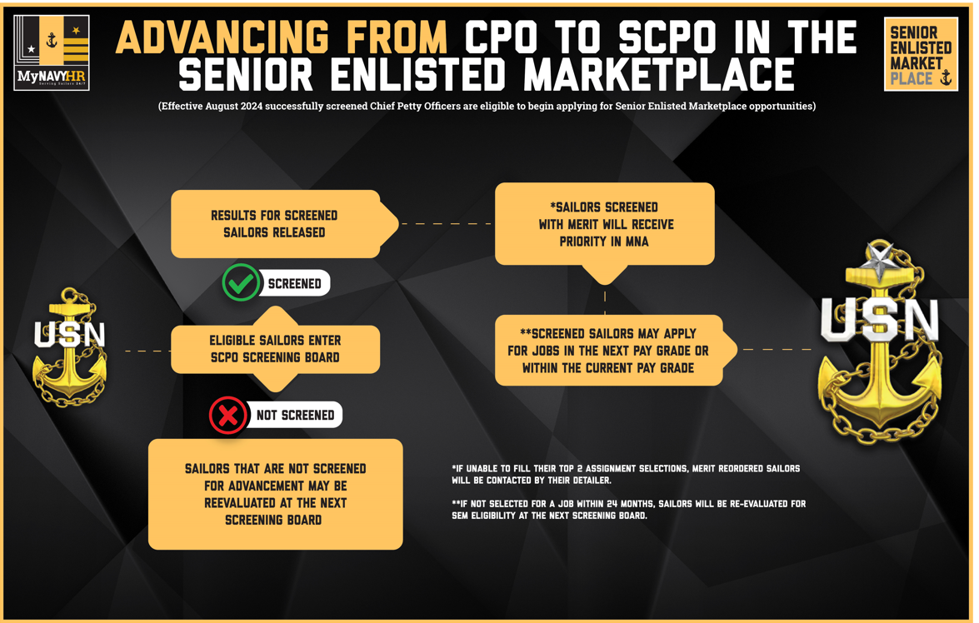
Enlisted Advancement Senior Enlisted Marketplace (SEM)
Notes:
FACILITATOR GUIDE:
None

Slide 31
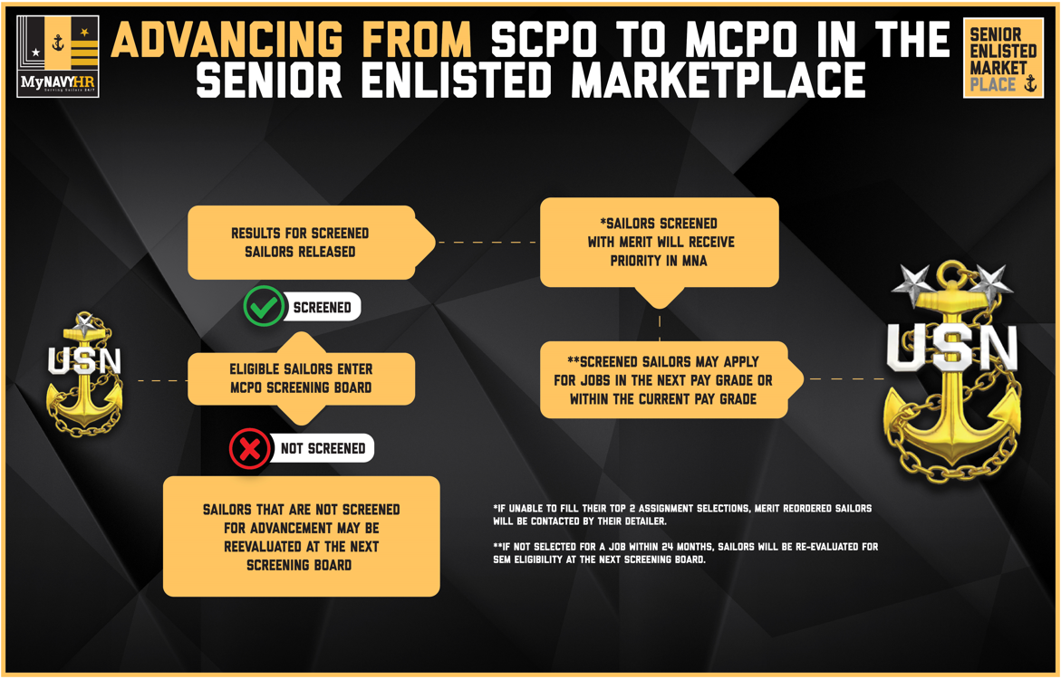
Enlisted Advancement Senior Enlisted Marketplace (SEM)
Notes:
FACILITATOR GUIDE:
None

Slide 32
Summary and Review
In this lesson we discussed
The Enlisted advancement process and eligibility requirements
Final Multiple Score (FMS) and contributing factors
Process for calculating Performance Mark Average (PMA) and Reporting Senior’s Cumulative Average (RSCA)
Time-in-Rate requirements
Passed-Not-Advanced (PNA) points and how it is awarded
Advancement incentive programs

Slide 33
Questions?

